Slide 1


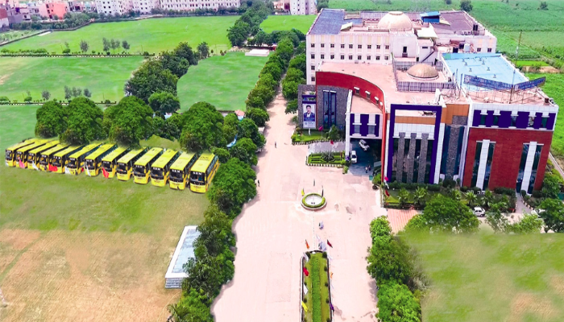
Department of Electrical and Electronics Engineering
SRM Institute of Science and Technology
Delhi-NCR Campus, Ghaziabad
Sustainable Energy (18EEO301T)

Slide 2
UNIT-1 SOLAR SYSTEM
Syllabus
1. Solar Radiation
Direct Radiation
Diffuse Radiation
Reflected Radiation
2. Solar Constant
3. Solar Angles/Sun Angles
Angle of Latitude
Inclination Angle
Zenith Angle
Solar Azimuth Angle
Tilt Angle or Slope
Angle of Incidence
Surface Azimuth Angle

Slide 3
UNIT-1 SOLAR SYSTEM continue
4.Solar Collectors
5. Types of Solar Collectors (a). Flat Plate Collectors
(b). Concentrating Collector
6. Solar Air Heaters
7. Type
8. Solar driers
9. storage of solar energy (a) Thermal energy storage (b) Electrical storage (c) Chemical storage (d) Mechanical storage (e) Electromagnetic Energy storage

Slide 4
UNIT-1 SOLAR SYSTEM continue
10. Solar Pond
11. Solar Water Heater/ Hot Water Supply System
12. Solar Distillation
13. Solar heating & cooling of buildings
14. Solar Stills
15. Solar Cooker- thermal
16. Solar Cell
17. V-I Characteristics of a Photovoltaic Cell
18. Working Principle of Solar Cell
19. Maximum Power Point Techniques
20. Net metering concepts

Slide 5
Course Learning Rationale (CLR)
Enrich the students on the basis of solar energy.
Develop the knowledge in wind energy conversion system.
Understand the energy generation by biomass.
Gain knowledge in fuel cell and its types
Apply the concepts of renewable energy in industrial applications

Slide 6
Course Learning Outcomes (CLO)
Obtain in depth knowledge on solar application.
Explain the concepts of wind energy conversion systems and their control.
Summarize the biomass knowledge and calculate the power conversion of biomass.
Interpret the environmental impacts of ocean and tidal energy.
Summarize the working principle of fuel cells and its types.
Inter the knowledge about various types of renewable energy systems

Slide 7
Solar Radiation(Electromagnetic energy) LECTURE-1

Slide 8
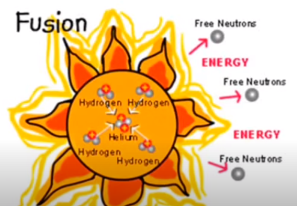
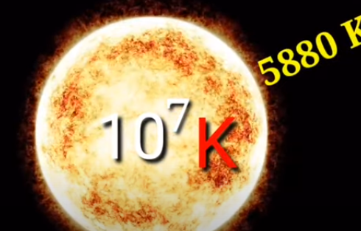
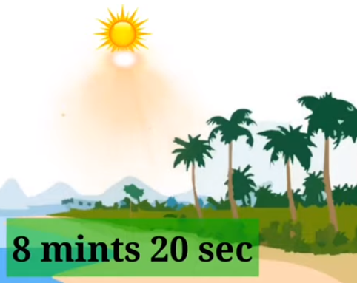
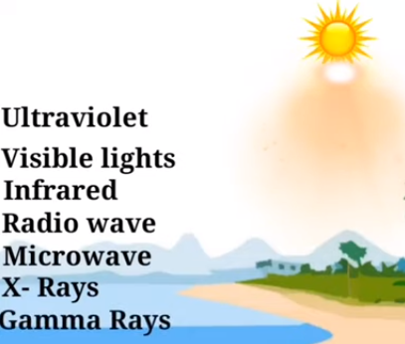
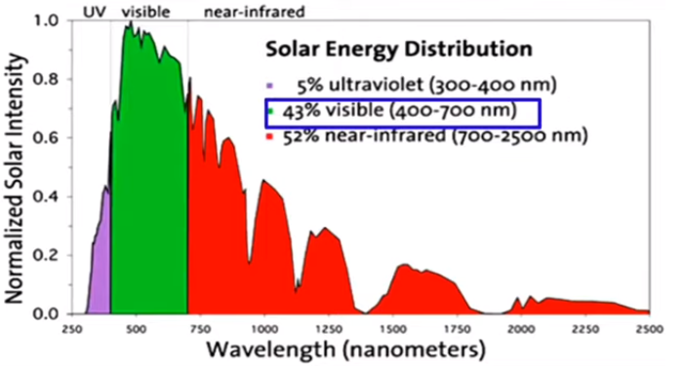

Slide 9
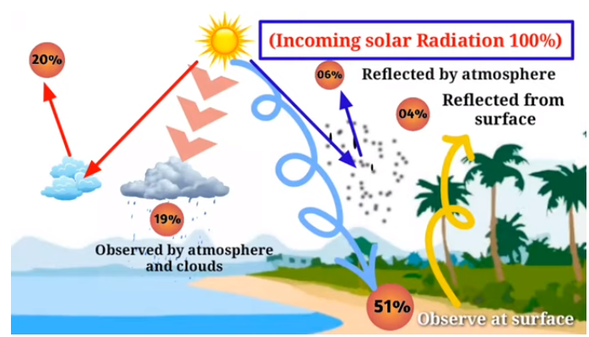

Slide 10
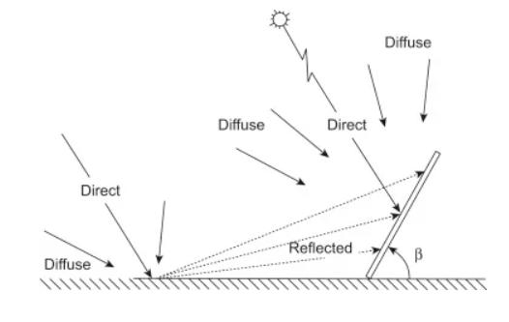
Solar Radiation(Electromagnetic energy) Lector-1 Direct Radiation Diffuse Radiation Reflected Radiation

Slide 11
Solar Constant
The amount of solar energy received per second by one square meter on near earth surface perpendicular to sun's and earth's mean distance from the sun ray.
solar constant = Energy / (Unit area x Unit time)
Value = 1.366 KJ/S/m2 (kW/m2)

Slide 12
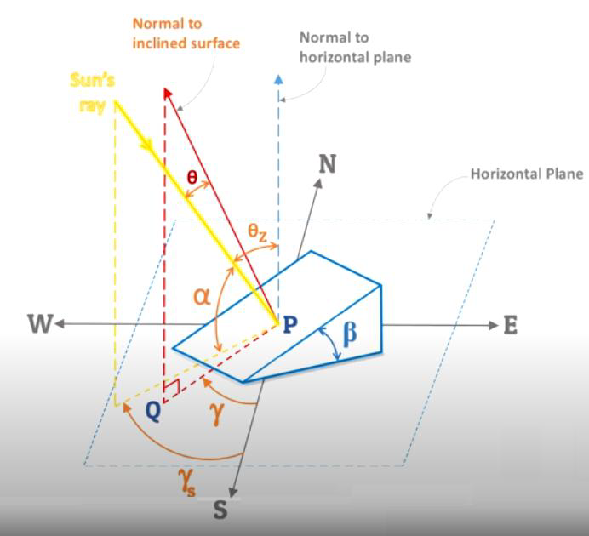
Solar Angles/Sun Angles 1. Angle of Latitude 2. Inclination Angle 3. Solar Zenith Angle 4. Tilt Angle or Slope 5. Angle of Incidence 6. Surface Azimuth Angle

Slide 13
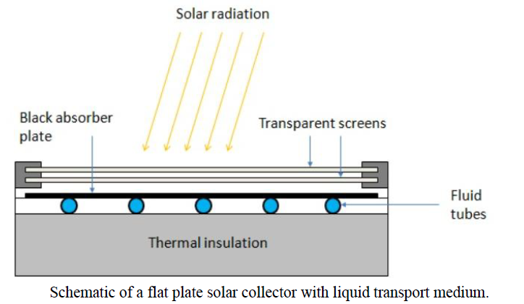
Solar Collectors Flat Plate Collector Concentrating Collector

Slide 14
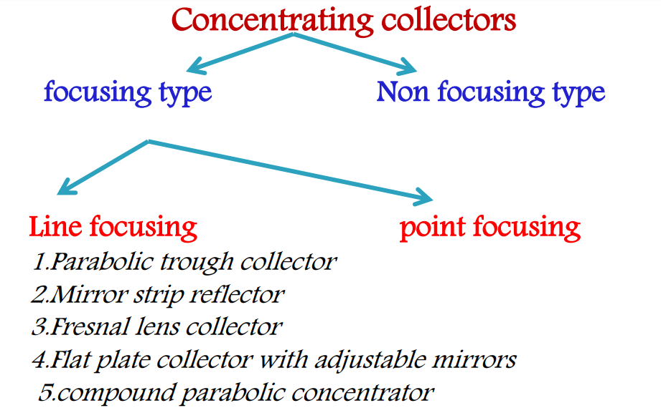
Concentrating Collector

Slide 15
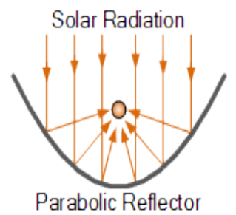
Parabolic Through Collector (PTR)

Slide 16
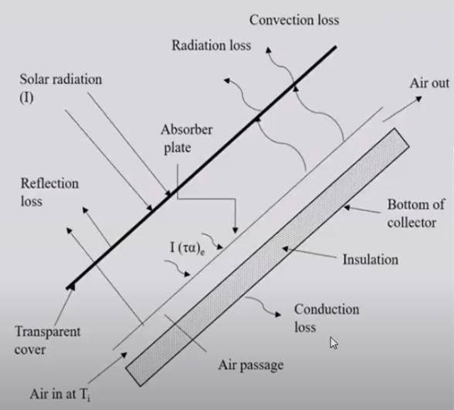
Solar Air Heaters Solar air heater with non-porous absorber and Solar air heater with porous absorber.

Slide 17
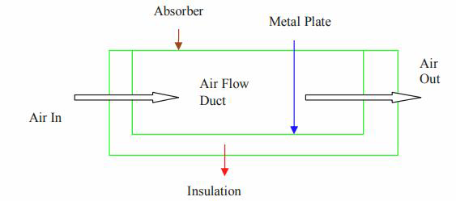

Slide 18
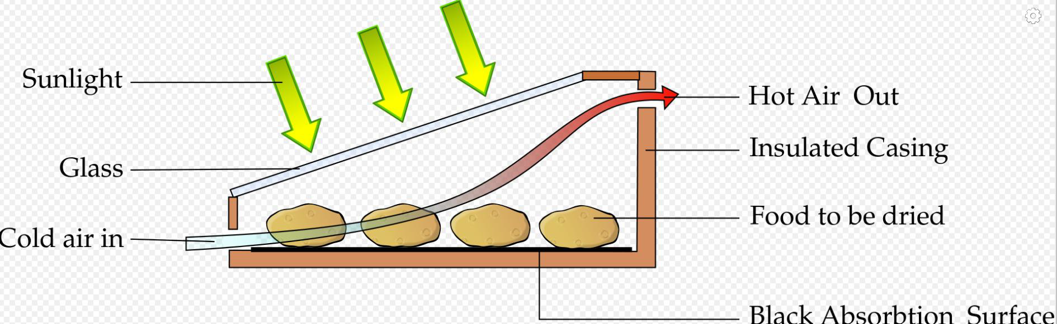
Solar Dryer Direct indirect

Slide 19
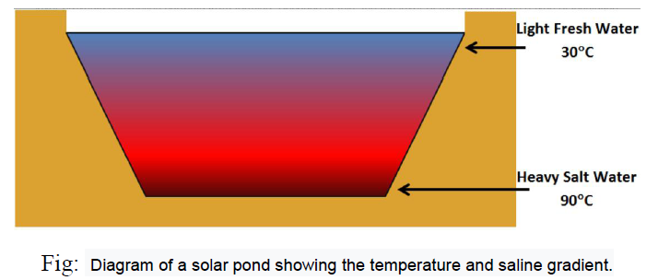
Solar Pond

Slide 20
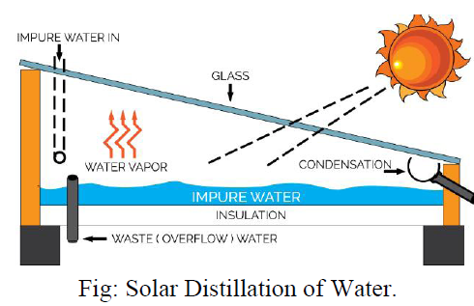
Solar Distillation

Slide 21
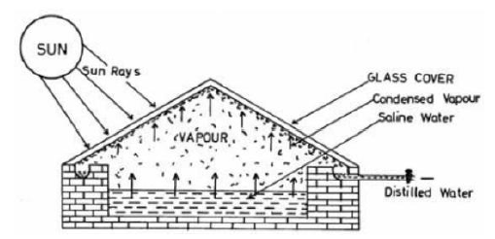
Solar Stills

Slide 22
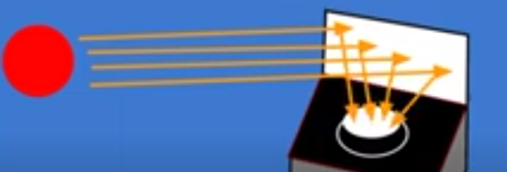
Solar Cooker life , time, Box cookers, Panel cookers and Reflectors cookers

Slide 23
Functions: i. Plane mirror has a special feature to maximise the amount of light entering the solar cooker. ii. Glass sheet-traps infra-red radiations which produces green-house effect. iii. Black paint absorbs radiation Application 1. cooking of food 2. heating of water 3. Making jams & jallies 4. Wax melting 5. Roasting coffee and peanuts

Slide 24
Advantages of solar cooker are
Saves conventional fuels.
No smoke and thus it is environment friendly.
Nutrients of food remain
Maximum of four food items can be cooked. Disadvantages of solar cooker are
Solar cookers cannot be used at night.
If the day is cloudy.
Direction of reflection need to chane.

Slide 25
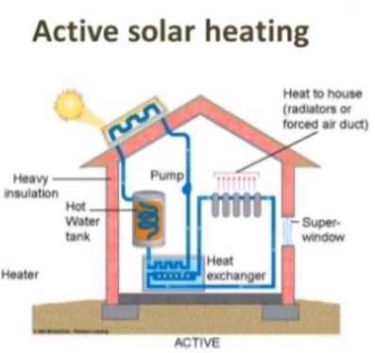
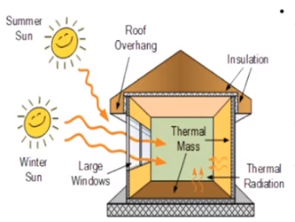
Solar heating & cooling of buildings

Slide 26
Solar Cell/Photovoltaic cell working
A device that converts the energy of light directly into electricity by the photovoltaic effect, which is a physical and chemical phenomenon.
A p-n junction diode.
It has specific electrical characteristics, such as current, resistance, and voltage, that change under light exposure

Slide 27


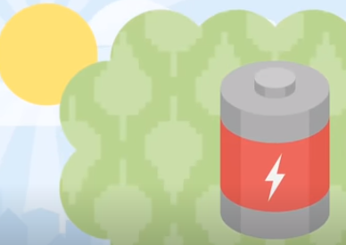
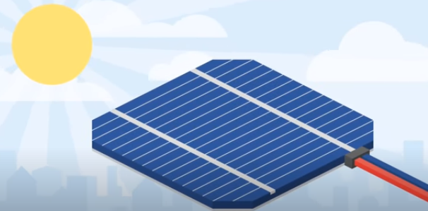
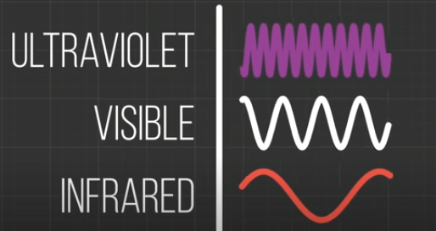
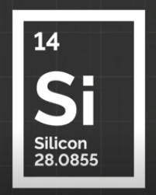

Slide 28
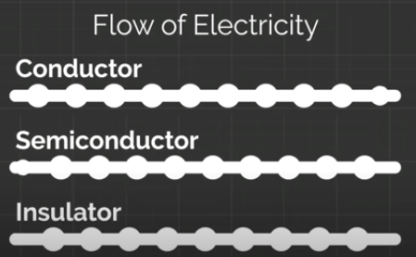

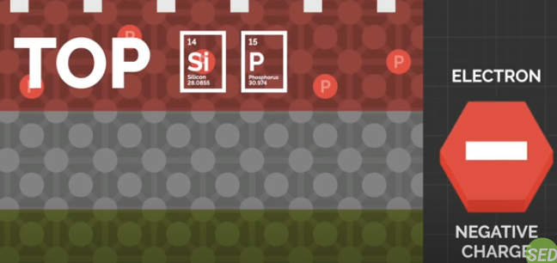
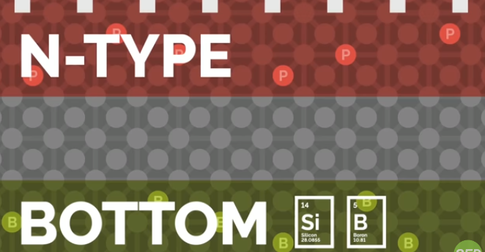
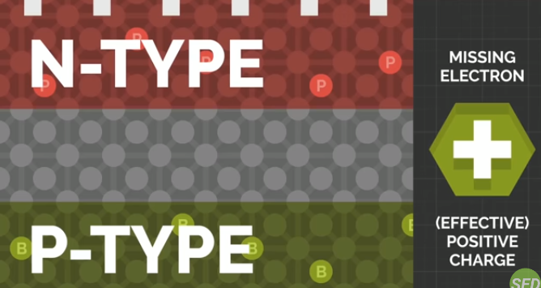
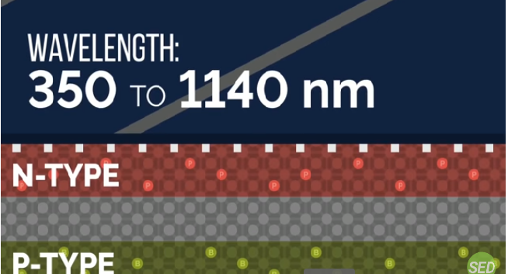

Slide 29
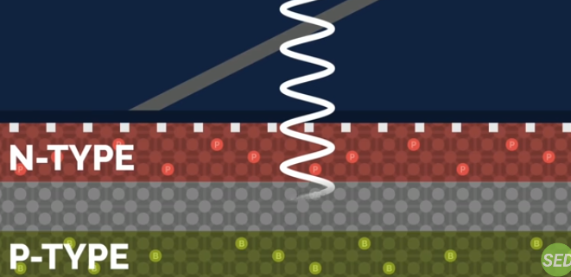
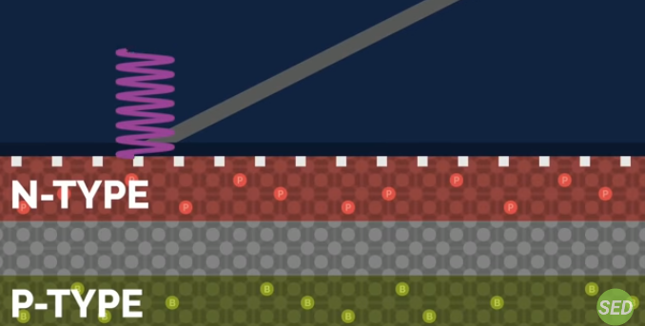
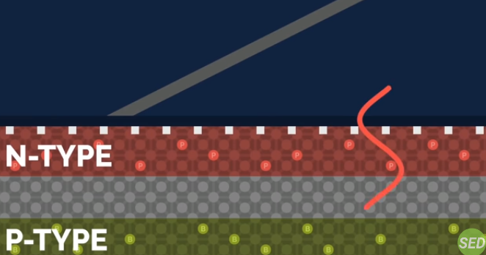
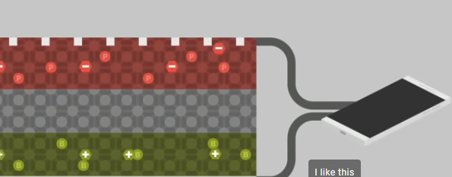
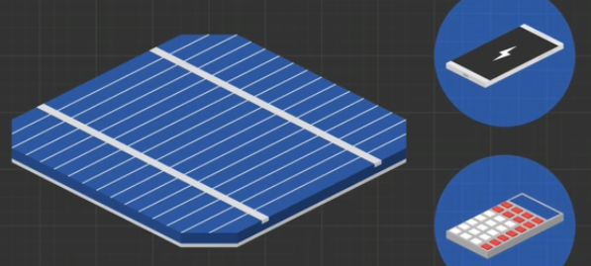
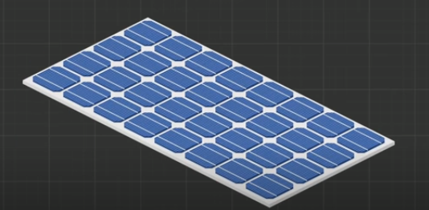
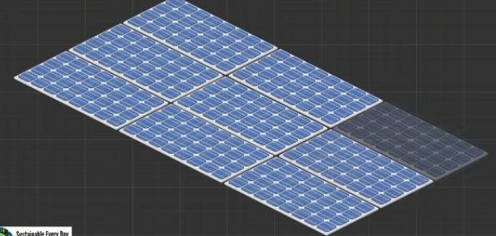

Slide 30
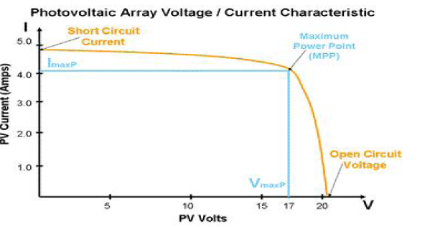
V-I Characteristics of a Photovoltaic Cell-

Slide 31
Maximum Power Point Techniques (Example-Car wash)
The factors that affect the output from the solar PV modules are
The Ambient Temperature
The solar cell Temperature
The solar radiation
Shading or partial shading
Duty cycle, resistance change,voltage / current
Controller : Optimization Algorithm method
To get output constant.

Slide 32
Maximum Power Point Techniques
Perturb & Observe Algorithm (P&O)
Incremental Conductance Algorithm (INC)
Direct method
Constant voltage
Current sweep Method
Temperature method.

Slide 33
Net metering concepts on-site self-generation solar power systems.
The concept of net metering first emerged in United States in 1979 as a way to compensate customers for their investment.
Policy
Surplus
Grid
bi-directional meter
backup
On grid system
Off grid system

Slide 34
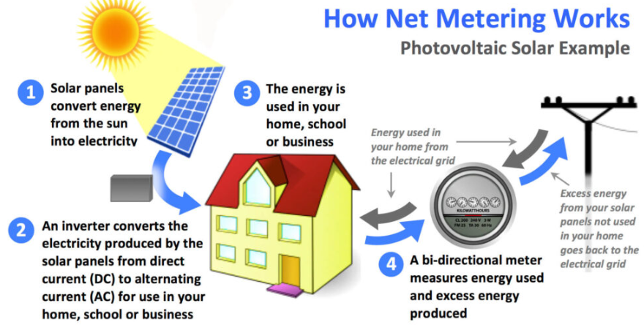
How Net Metering Works

Slide 35
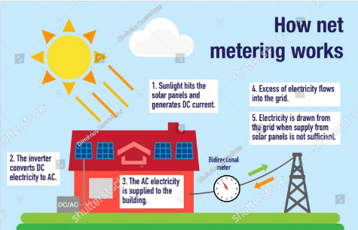

Slide 36
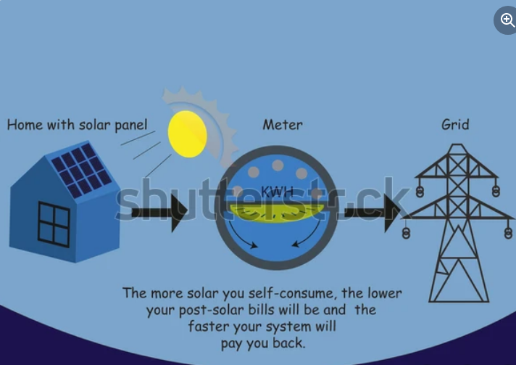

Slide 37


